Slide 1
Offer Letter – Job Aid
Copyright © 2017 Accenture. All rights reserved.

Slide 2

CONGRATULATIONS ON YOUR OFFER
Copyright © 2017 Accenture. All rights reserved.

Slide 3
LET’S HAVE A LOOK AT IT . . .
Copyright © 2017 Accenture. All rights reserved.

Slide 4


Navigate to the India Jobs Portal
Copyright © 2017 Accenture. All rights reserved.

Slide 5

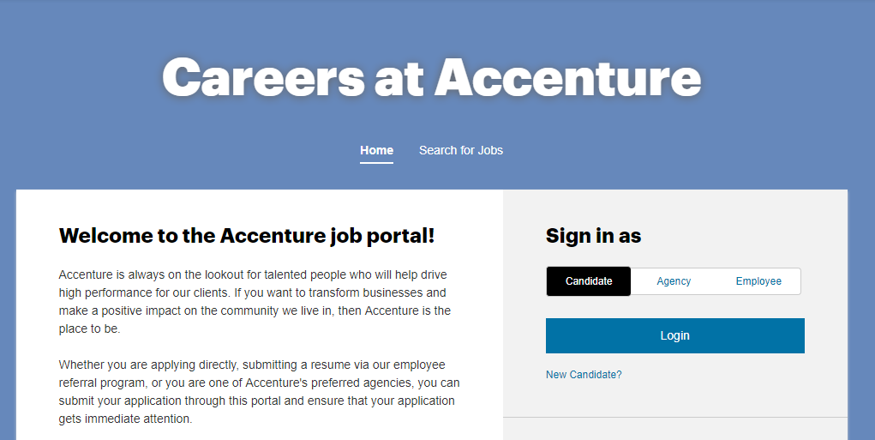
  Navigate to the India Jobs Portal
Copyright © 2017 Accenture. All rights reserved.

Slide 6
Do you have a Login ID and Password?
Copyright © 2017 Accenture. All rights reserved.

Slide 7
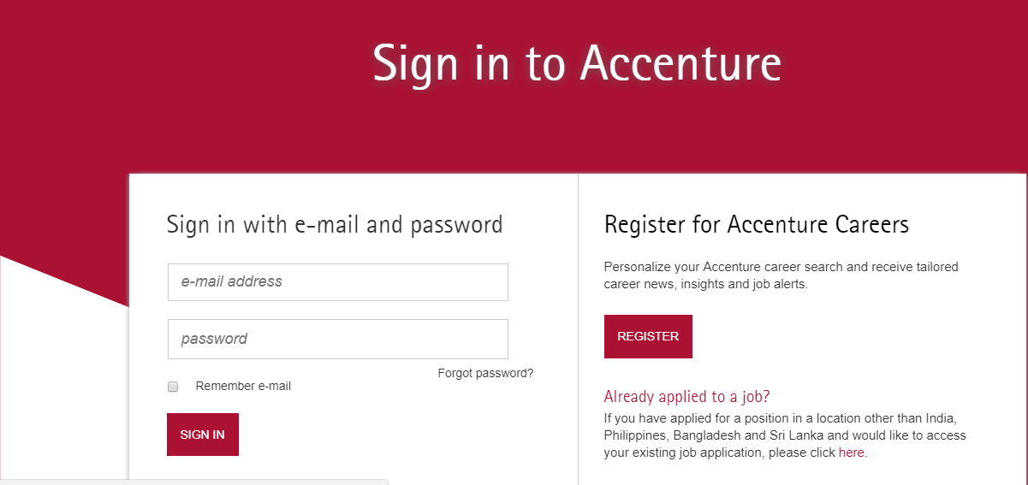
Navigate to Reset Password
Copyright © 2017 Accenture. All rights reserved.

Slide 8
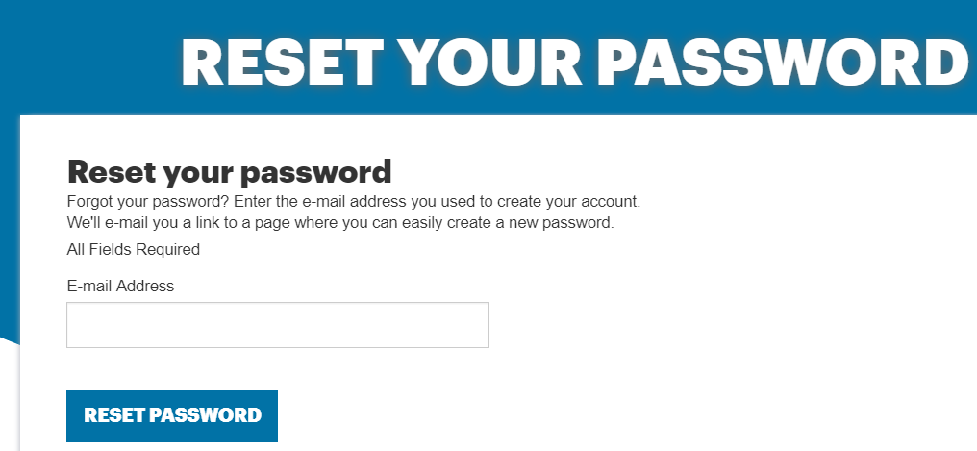
Generating Reset Link
ENTER EMAIL ADDRESS
Copyright © 2017 Accenture. All rights reserved.

Slide 9
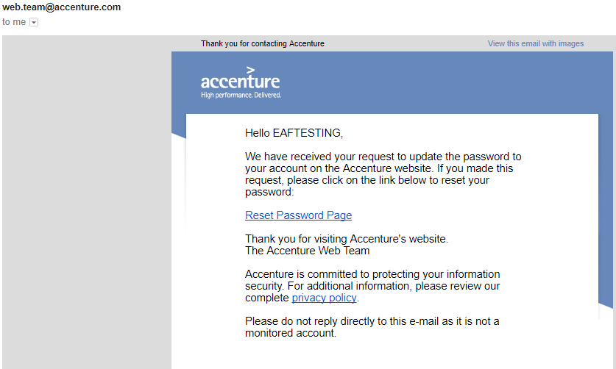
Check your Email
Copyright © 2017 Accenture. All rights reserved.

Slide 10
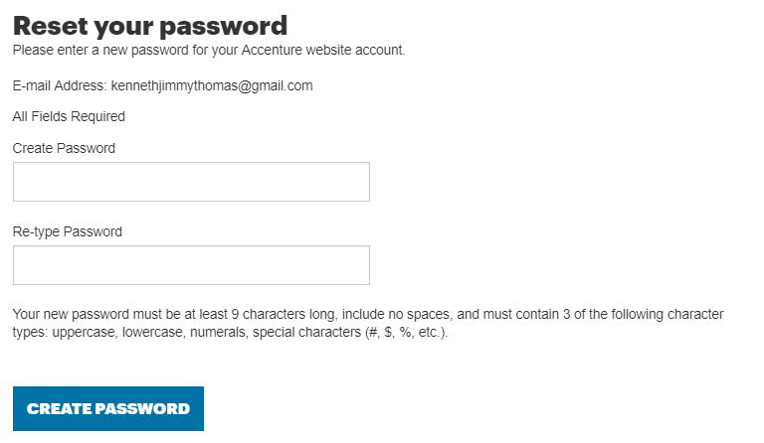
Reset your password
ENTER NEW PASSWORD
CONFIRM NEW PASSWORD
Copyright © 2017 Accenture. All rights reserved.

Slide 11
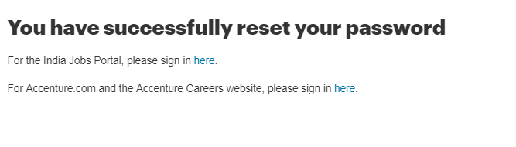
Password is Set.
Navigate to the India Jobs Portal
Copyright © 2017 Accenture. All rights reserved.

Slide 12
Navigate to the India Jobs Portal
Copyright © 2017 Accenture. All rights reserved.

Slide 13

Signing in to the India Jobs Portal
ENTER EMAIL ADDRESS
ENTER PASSWORD
Copyright © 2017 Accenture. All rights reserved.

Slide 14
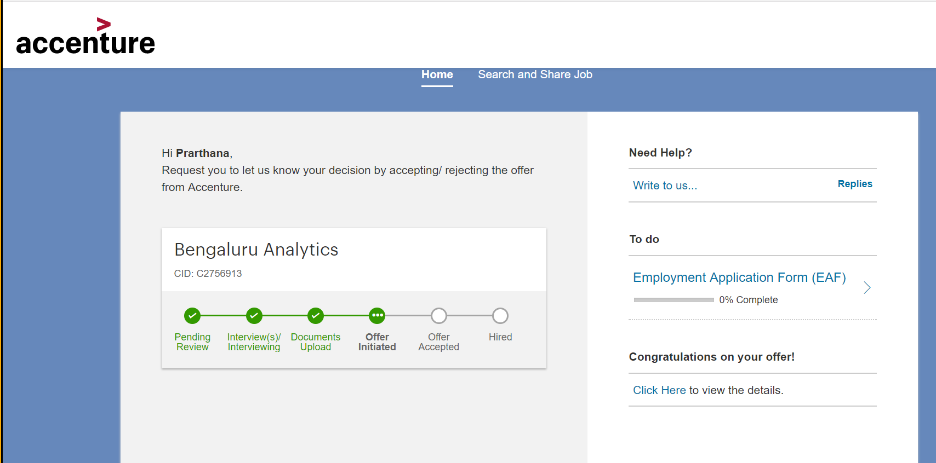
Opening the Offer Letter
Copyright © 2017 Accenture. All rights reserved.

Slide 15
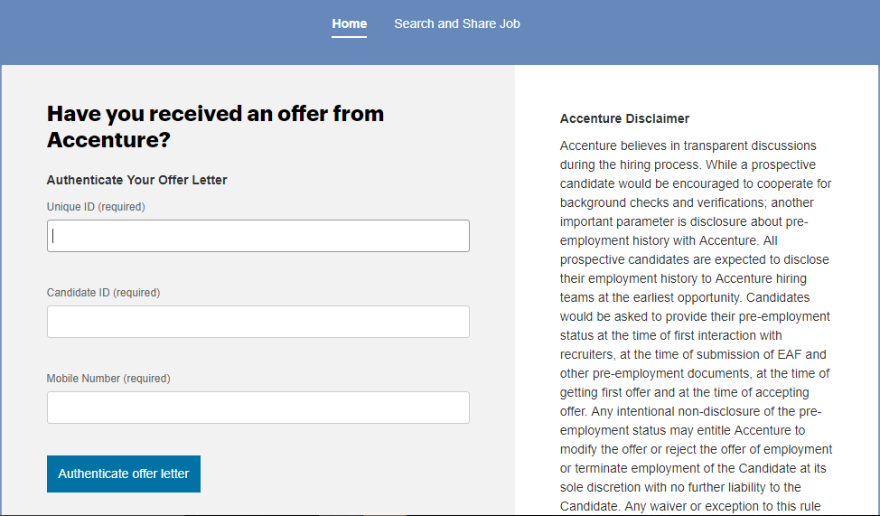
Authenticating the Offer Letter
ENTER UNIQUE REFERENCE ID
ENTER YOUR CANDIDATE ID
ENTER YOUR MOBILE NO.
Copyright © 2017 Accenture. All rights reserved.

Slide 16
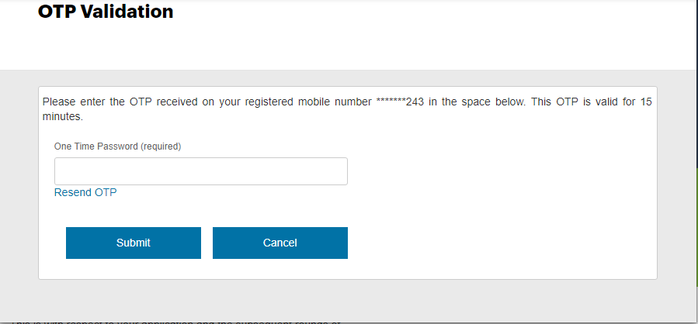
Authenticating the Offer Letter
ENTER THE OTP
Copyright © 2017 Accenture. All rights reserved.

Slide 17
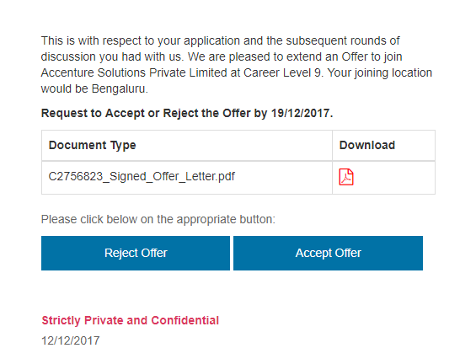
Downloading the Offer Letter
Copyright © 2017 Accenture. All rights reserved.

Slide 18
Accepting the Offer Letter
Copyright © 2017 Accenture. All rights reserved.

Slide 19
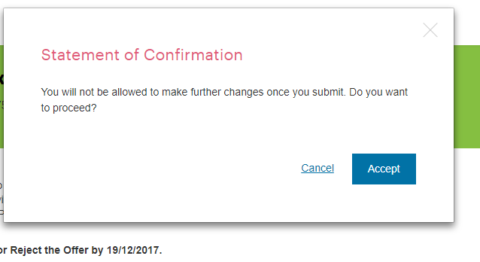
Accepting the Offer Letter
Copyright © 2017 Accenture. All rights reserved.

Slide 20
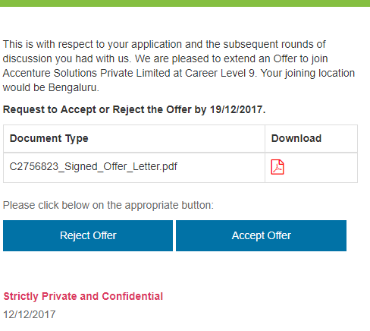
Rejecting the Offer
Copyright © 2017 Accenture. All rights reserved.

Slide 21
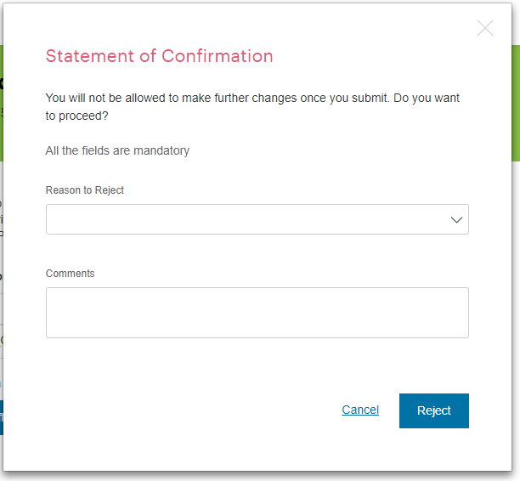
Rejecting the Offer
Copyright © 2017 Accenture. All rights reserved.

Slide 22
If you are unable
to see your offer letter
Get in touch with the person
mentioned in the email
Copyright © 2017 Accenture. All rights reserved.

Slide 23
Thank you . . .
Copyright © 2017 Accenture. All rights reserved.

